Slide 1
Optimizing Layout of a particle experiment
Group: Cédric Renda, Sandro Gälli, Marvin Sigg

Slide 2
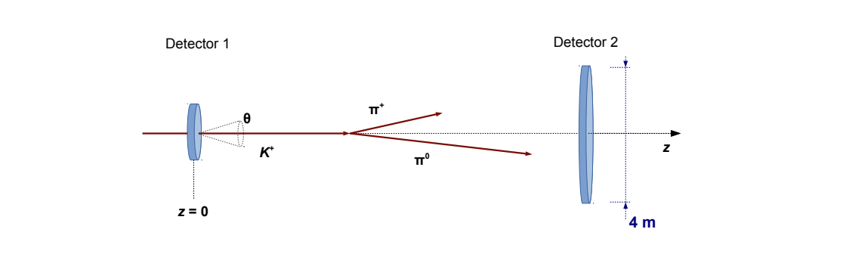
Experiment setup

Slide 3
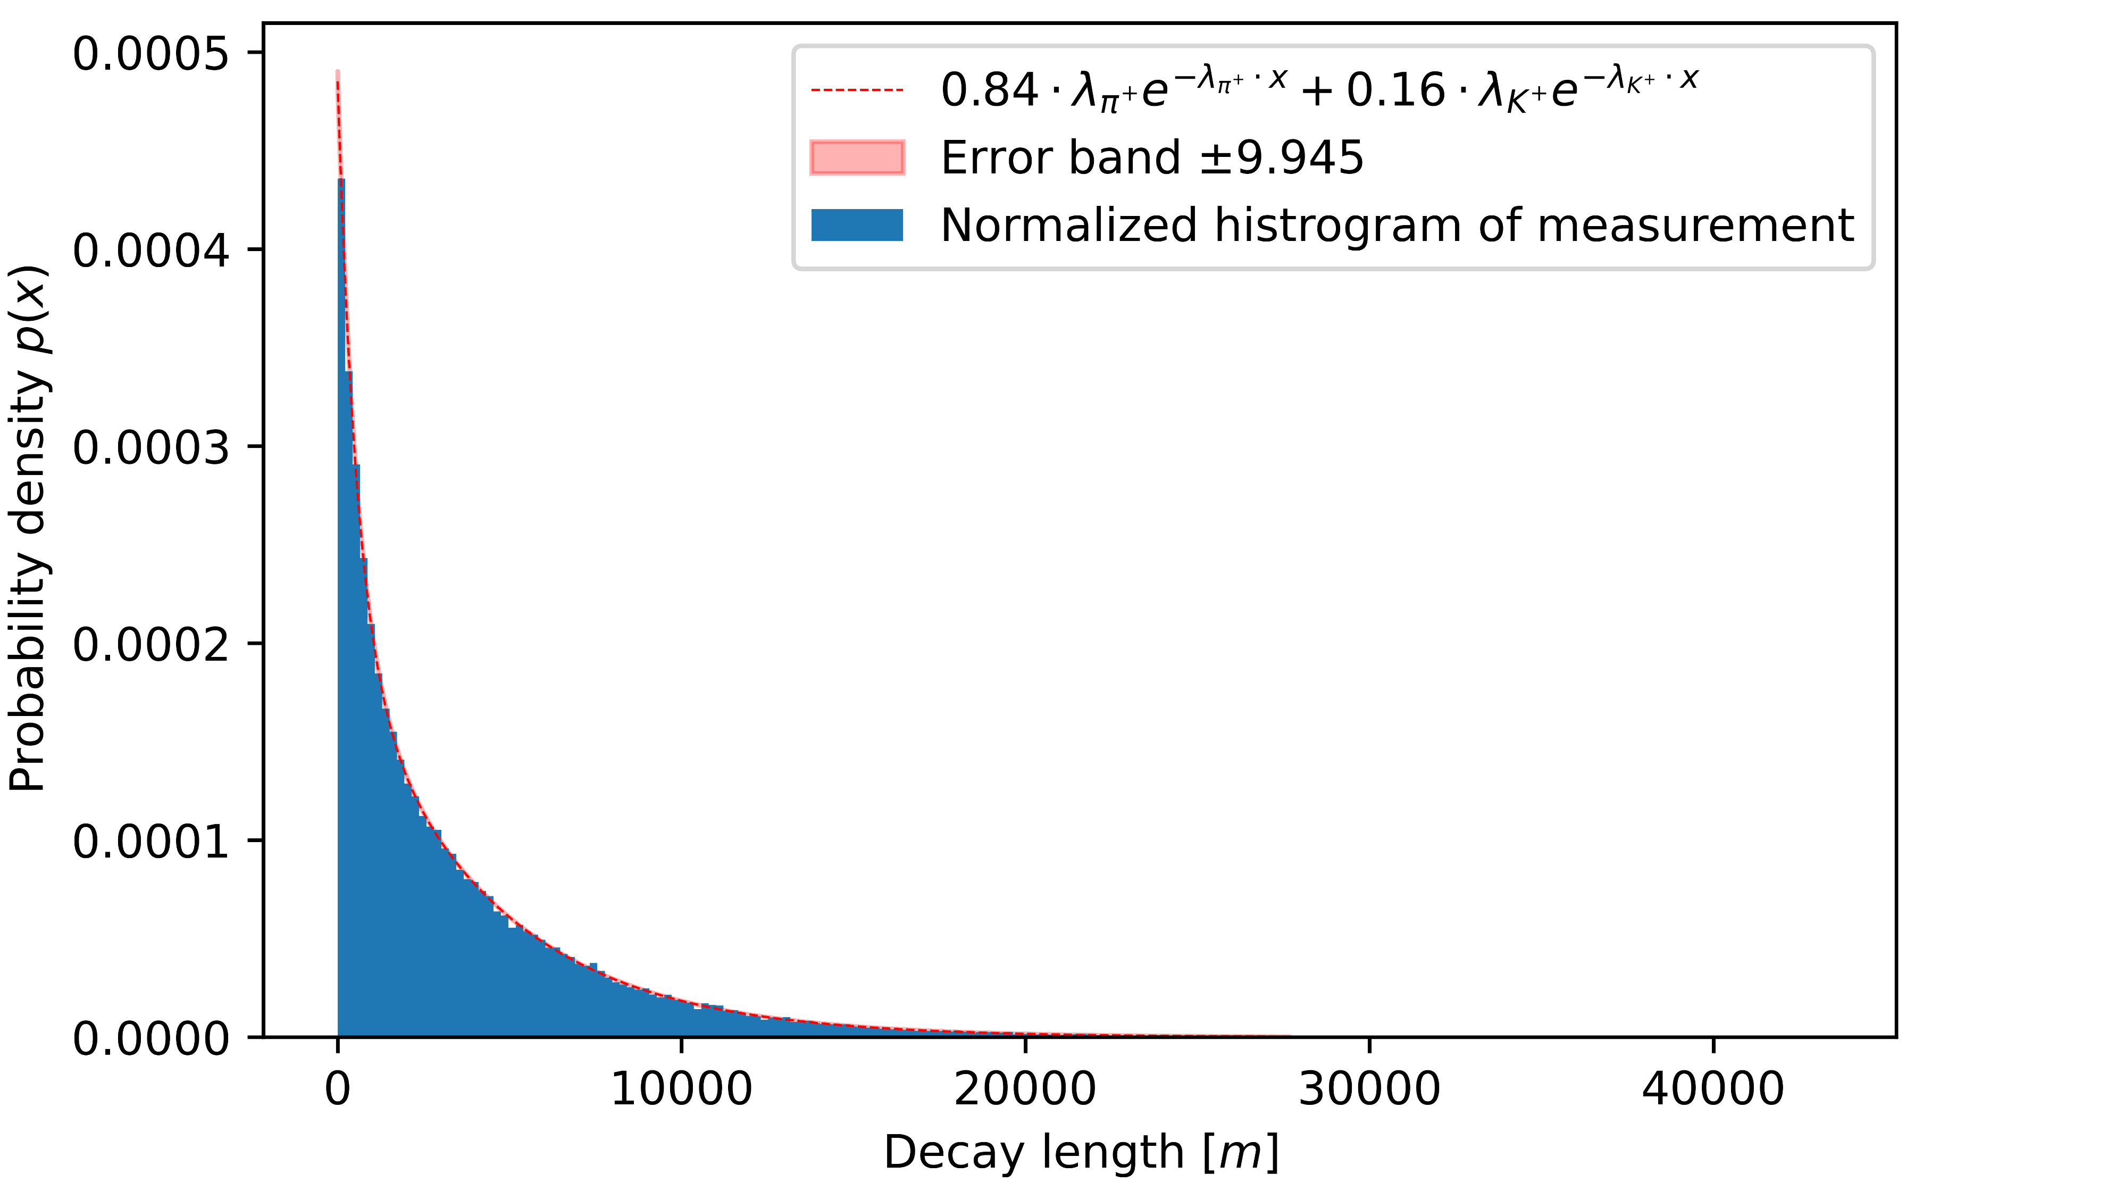
Determination of the average decay length of the K+

Slide 4
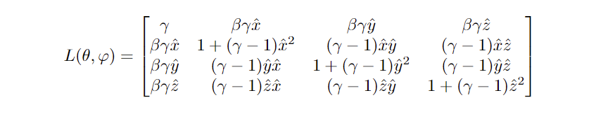
Infinitely narrow beam along the z axis

